Slide 1
Data Storytelling
BS DATA SCIENCE
From charts to a decision
W08-S01 · Introduction to Data Science
Notes:
Guide W08-S01. Tell the story first. The midterm is after the break.

Slide 2
Twelve charts. Thirty seconds. One question: what should I do?
Noor’s deck was accurate, and nobody could use it.
A finding nobody acts on is a finding nobody has really made.
W08-S02 · Introduction to Data Science
Notes:
Guide W08-S02. Tell the full story from the guide before advancing.

Slide 3
Today
Before the break
Review
Turn an analysis into a one-slide story: headline, evidence, so what
Five quick refreshers on Weeks 1 to 7
Storytelling is the last skill of the first half. It is how the earlier work becomes useful.
W08-S03 · Introduction to Data Science
Notes:
Guide W08-S03. Set the plan for the day.

Slide 4
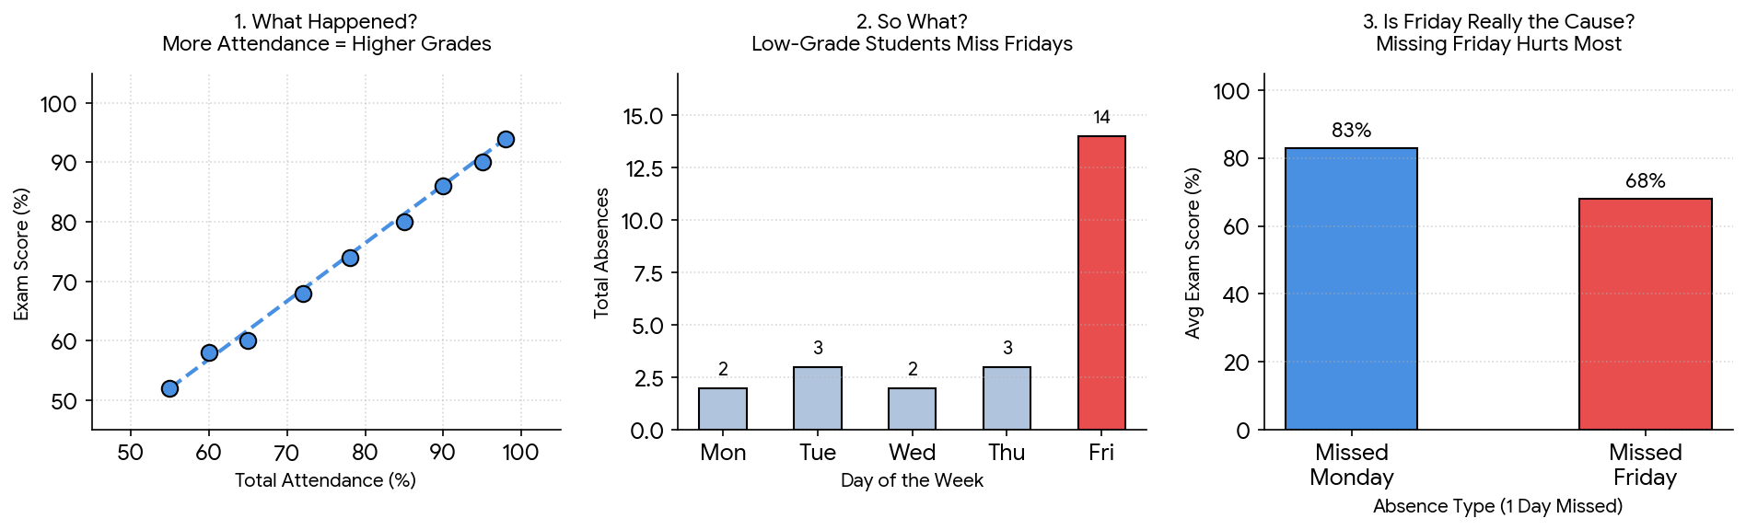
The so-what test
What happened?
So what?
Now what?
The chart or number: Home revenue fell.
Why it matters: the range is shrinking while others grow.
The action: review the range before next season.
A slide that stops at the first question is a report. A slide that reaches the third is a decision.
W08-S04 · Introduction to Data Science
Notes:
Guide W08-S04. Ask where the last chart students drew stopped.

Slide 5
The title ladder
Level | Example
No title | (blank)
Topic title | Revenue by department
Insight title | Womenswear earns 31 percent of revenue
Decision title | Home revenue fell 41 percent in two years: review the range
Climb as high as the evidence allows. Do not claim a decision the data cannot support.
W08-S05 · Introduction to Data Science
Notes:
Guide W08-S05. Students rewrite two of their Week 7 chart titles.

Slide 6
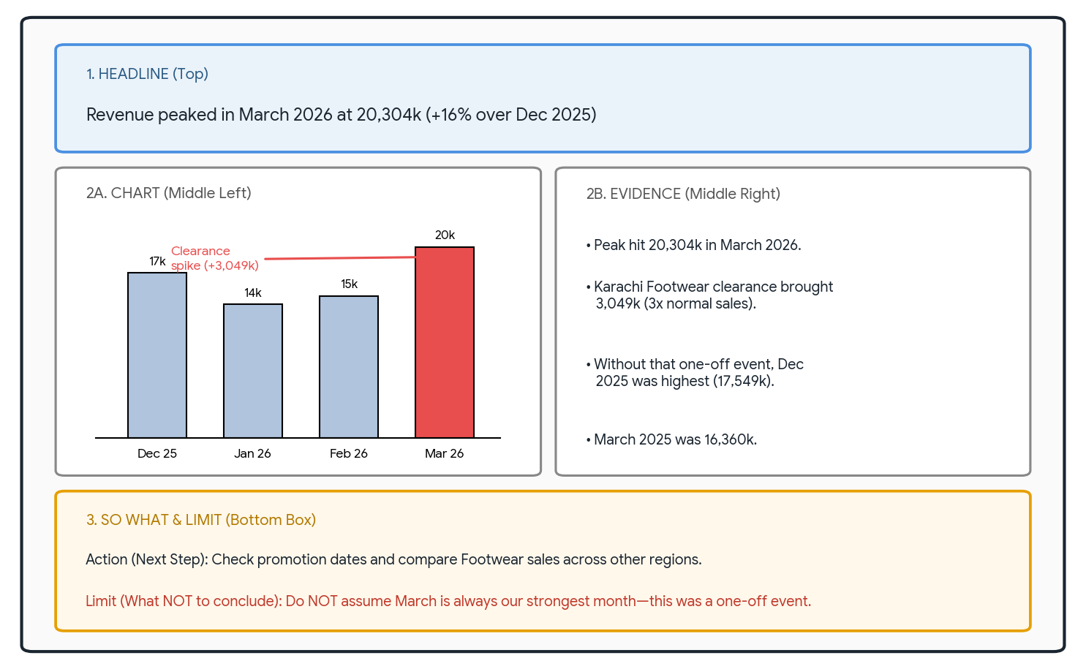
One-slide story: three parts
Headline
Evidence
So what
One sentence: what changed, by how much
One chart that shows it, annotated, plus two or three facts
One action, and one limit: what we cannot say
If it needs a second slide, you have not decided what the point is.
W08-S06 · Introduction to Data Science
Notes:
Guide W08-S06. Show the structure on the board.

Slide 7
Four questions before you present
What happened?
What might explain it?
State it in one sentence.
Two possible causes, not a certainty.
What would we need to know?
What should we NOT conclude?
The data that would confirm or kill each cause.
Name the claim the data cannot support.
W08-S07 · Introduction to Data Science
Notes:
Guide W08-S07. Run it on the March 2026 revenue peak from Week 7.

Slide 8
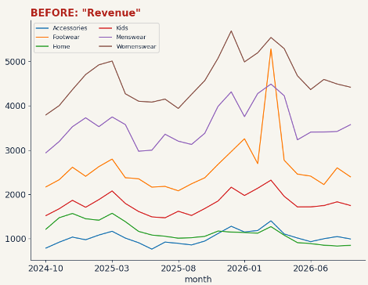
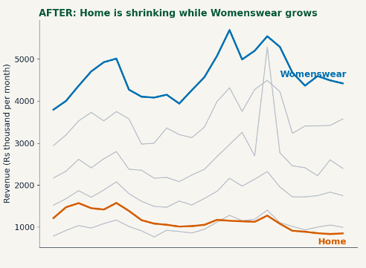
Annotate, do not decorate
Grey out the rest, colour the story, label lines directly, and put the finding in the title.
W08-S08 · Introduction to Data Science
Notes:
Guide W08-S08. Ask what the reader sees first in each version.

Slide 9
Audience and purpose
Audience | Needs | Time | Include
An executive | The decision and its cost | 30 seconds | Headline, one chart, one action
Your team | How it was found | 5 minutes | Method, caveats, next steps
Classmates or examiners | That you understand it | 10 minutes | Method, limits, what could be wrong
W08-S09 · Introduction to Data Science
Notes:
Guide W08-S09. Ask who the audience for the final project will be.

Slide 10
Writing the headline
Weak | Strong
Sales were up | Sales rose 4 percent from Q1 to Q2
Karachi is large | Karachi earns a third of revenue, but Peshawar is growing faster
Discounts matter | Deeper discounts sell more units (r = 0.38), but we cannot say they cause it
Formula: what changed + by how much + the reason it matters or the limit on the claim.
W08-S10 · Introduction to Data Science
Notes:
Guide W08-S10. Students improve two weak headlines.

Slide 11
Mini-lab: three findings, three headlines
Womenswear earns 110,509k, 31 percent of revenue
Karachi and Lahore have the highest medians (650 and 642)
Home fell from 1,415k to 841k a month
Write a headline and one so-what for each. Compare with a neighbour. 8 minutes.
W08-S11 · Introduction to Data Science
Notes:
Guide W08-S11. Collect headlines on the board and vote on the strongest.

Slide 12
Lab: one-slide story
Data
Make
Time
shop_monthly.csv from Week 7 and your five charts
One slide: an insight headline, one annotated chart, two or three evidence points, one so-what and one limit
20 minutes. Foundation: use the Home finding. Core: pick your own. Stretch: add a second chart.
W08-S12 · Introduction to Data Science
Notes:
Guide W08-S12. Students may build it in Colab, PowerPoint or on paper.

Slide 13
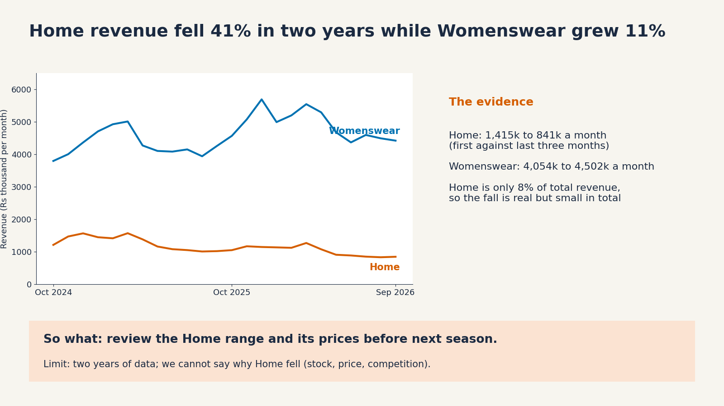
A model slide
Headline, evidence, so what, limit. Your slide does not need to look like this, but it needs all four.
W08-S13 · Introduction to Data Science
Notes:
Guide W08-S13. Compare with the students’ slides.

Slide 14
The midterm
Section | Marks | What it asks
A Concepts | 6 | Choose the best answer
B Interpretation | 6 | Read a summary or chart and say what it means
C Python and Pandas | 6 | Read short code, predict, fix
D Data reasoning | 6 | Spot problems in a small table and say what to do
E Scenario | 6 | Plan the first steps of an investigation
30 marks. Weeks 1 to 8. No long programs to write.
W08-S14 · Introduction to Data Science
Notes:
Guide W08-S14. Read the table aloud; answer questions about format only.

Slide 15
Review: Weeks 1 and 2
Think
Python
Habit
Seven Questions. What does one row represent?
Types, lists, dicts, loops, functions, try/except
Say the plan in English, predict the output, test it
Bad rows are evidence: record them, never hide them.
W08-S15 · Introduction to Data Science
Notes:
Guide W08-S15. One minute per card; cold-call for an example.

Slide 16
Review: Weeks 3 and 4
Pandas
Quality
Habit
Inspect, filter with & and parentheses, groupby, grain
Six dimensions; missing, duplicates, invalid values, categories
Raw data stays raw; every change has a reason in a log
len counts rows. nunique counts distinct values. An outlier is not an error.
W08-S16 · Introduction to Data Science
Notes:
Guide W08-S16. Ask what 999 in an age column should become.

Slide 17
Review: Weeks 5 and 6
Describe
Sample
Doubt
Mean, median, spread, IQR, skew; plot as well as summarise
Bias beats size; base rates; the four reasons for a correlation
Confounders, Simpson’s paradox, lucky correlations
One number never describes a dataset. A correct number can still mislead.
W08-S17 · Introduction to Data Science
Notes:
Guide W08-S17. Ask for the median against mean rule for salaries.

Slide 18
Review: Week 7 and today
Charts
Titles
Story
Question first. Bars from zero. Sorted. Safe colours.
Insight titles, not topic titles
Headline, evidence, so what, and one limit
A chart is a promise about the data. Keep it.
W08-S18 · Introduction to Data Science
Notes:
Guide W08-S18. Ask what is wrong with a bar chart that starts at 470.

Slide 19
Exam tips
Read each question twice; underline what it asks
Show your reasoning: a short reason earns marks a bare answer cannot
In code questions, say in English what each line does first
When asked what you can conclude, also say what you cannot
If stuck, move on and return; leave no section blank
W08-S19 · Introduction to Data Science
Notes:
Guide W08-S19. Read aloud, then hand out the paper after the break.

Slide 20
Practice (optional, send before the exam)
What does one row represent in a table of order lines?
Ages of 999 appear in a column. What do you do first?
For 20, 22, 21, 23, 25, 500: which is the better typical value, mean or median?
A survey posted in the AI club chat says 92 percent like AI. Name the problem.
Ice-cream sales and rescue calls rise together. Give a reason other than cause.
A bar chart axis starts at 470. What is wrong?
W08-S20 · Introduction to Data Science
Notes:
Guide W08-S20. Optional: send these on the portal before the exam.

Slide 21
Practice: answers
One order line, so the same order appears on several rows
Treat as missing, count them, log the decision and the reason
The median (22.5); the mean (101.8) describes nobody
Sampling bias: the people who answered are not all students
Hot weather drives both: a third factor
Bars must start at zero; the cut makes small differences look huge
W08-S21 · Introduction to Data Science
Notes:
Guide W08-S21. Answers for the practice questions.

Slide 22
Good luck
Read
Reason
Next week
Twice. Then answer.
Short reasons earn marks.
SQL: asking a database questions
W08-S22 · Introduction to Data Science
Notes:
Guide W08-S22. Hand out the midterm after the break.

